Slide 1
Random Forest
ADA AI/ML April, 2023

Slide 2
Introduction
Random forest is a supervised machine learning that is used widely in classification and regression problems.
It builds decision trees on different samples and takes their majority vote for classification and average in case of regression.
It can handle both the data set containing continuous variables, and categorical variables.

Slide 3
Introduction
Random forest is an ensemble learning technique.
Ensemble simply means combining multiple models. So, a collection of models is used to make predictions rather than an individual model.
Ensemble uses two main types of learning strategies:
Bagging– It creates a different training subset from sample training data with replacement & the final output is based on majority voting. For example, Random Forest.
Boosting– It combines weak learners into strong learners by creating sequential models such that the final model has the highest accuracy. For example, ADA BOOST, XG BOOST.

Slide 4
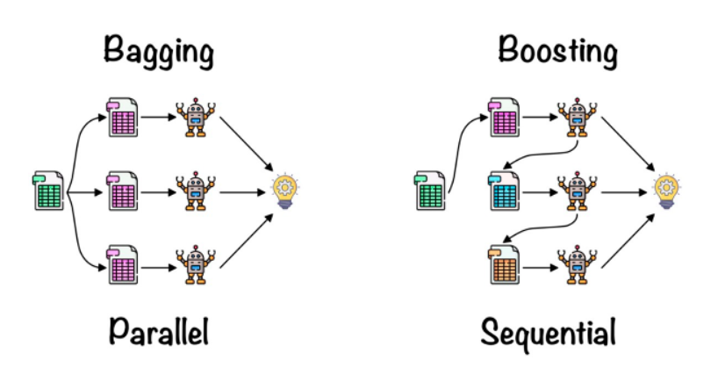
Ensemble learning strategies

Slide 5
Bagging
Bagging, also known as Bootstrap Aggregation, is the ensemble technique used by random forest.
Bagging chooses a random sample/random subset from the entire data set. Hence each model is generated from the samples (Bootstrap Samples) provided by the Original Data with replacement known as row sampling. This step of row sampling with replacement is called bootstrap.
Each model is trained independently, which generates results.
The final output is based on majority voting after combining the results of all models. This step is known as aggregation.

Slide 6
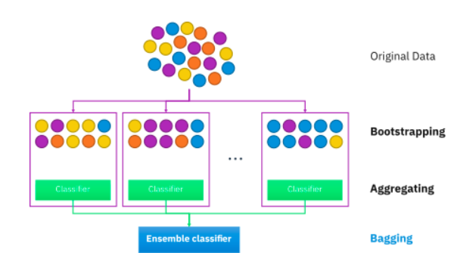
Bagging

Slide 7
Steps in Random Forest algorithm
Step 1: A subset of data points and a subset of features is selected for constructing each decision tree. Simply put, n random records and m features are taken from the data set having k number of records.
Step 2: Individual decision trees are constructed for each sample.
Step 3: Each decision tree will generate an output.
Step 4: Final output is considered based on Majority Voting or Averaging for classification and regression, respectively.

Slide 8
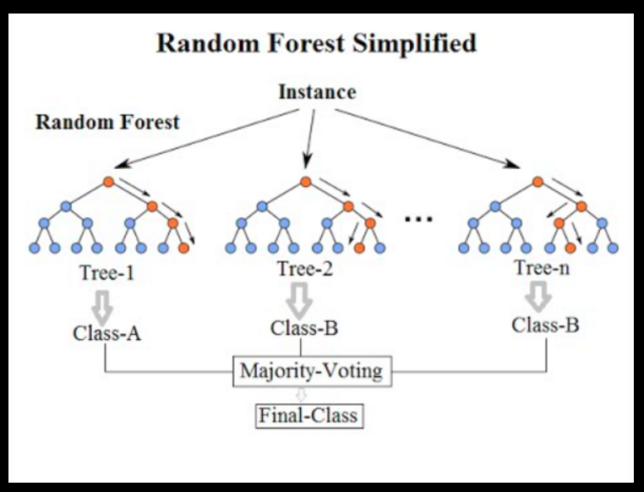
Steps in Random Forest algorithm

Slide 9
Important features
Diversity: Not all attributes/variables/features are considered while making an individual tree; each tree is different.
Immune to the curse of dimensionality: Since each tree does not consider all the features, the feature space is reduced.
Parallelization: Each tree is created independently out of different data and attributes. This means we can fully use the CPU to build random forests.
Stability: The result is based on majority voting/ averaging.

Slide 10
Decision Tree vs. Random Forest
Decision Tree:
Decision trees are prone to overfitting.
A single decision tree is faster in computation.
When a data set with features is taken as input by a decision tree, it will formulate some rules to make predictions.
Random Forest:
The final output is based on average or majority ranking; hence the problem of overfitting is taken care of.
It is comparatively slower.
Random forest randomly selects observations, builds a decision tree, and takes the average result.

Slide 11
Pros & Cons
Cons:
Complexity
RFs construction is much more time- and labor-intensive.
RFs requires more computational power to implement.
Less intuitive.
Prediction process may take a long time compared to some other algorithms.
RFs are difficult to interpret.
Pros:
RFs solve the overfitting issue
RFs perform better for a wide range of data items than a single decision tree
RFs has a lower variance than a single decision tree.
RFs automatically create uncorrelated decision trees and carry out feature selection.
RFs do not require data scaling.
RF stolerate well outliers and missing data.
Both linear and non-linear relationships are well-handled

